Slide 1


Clinical Problem Solving CARDIOLOGY + INTERNAL MEDICINE
IN THE NAME OF GOD
ALI RAFIEI , MD
CARDIOLOGY RESIDENT
DECEMBER 2025

Slide 2
ID
71 YO WOMAN
FROM TEHRAN
MARRIED
RETIRED TEACHER
DATE OF ADMISSON : 1404/08/19

Slide 3
CHIEF COMPLAINT
shortness of breath

Slide 4
Present Illness
A 71-year-old woman with no known past medical history presented with progressive shortness of breath for the past one week.
The dyspnea occurs only with exertion and is consistent with NYHA functional class II.
It has a gradual onset and is progressive, without any sudden deterioration.
The symptoms worsen with physical activity and exacerbated in the supine position
The dyspnea does not vary at different times of the day.
She denies dyspnea at rest, as well as cough, wheezing, or hemoptysis.
She denies orthopnea and paroxysmal nocturnal dyspnea (PND) .
She denies chest pain and palpitations.
No history of fever or flu-like symptoms

Slide 5
Present Illness
Additionally, she has developed progressive bilateral lower extremity edema over the past 3–4 days, which is non-painful.
She denies any history of recent immobilization, surgery, prolonged travel, or other thromboembolic risk factors. There has been no change in urine output
She reports a several-year history of early satiety, gastroesophageal reflux, and dysphagia, with significant progression over the last 4–5 months. Dysphagia was initially limited to solids and has since progressed

Slide 6
Past Medical History
The patient has a history of gastroesophageal reflux disease (GERD). She has no other known chronic medical conditions.
She has undergone three upper gastrointestinal endoscopies and two colonoscopies in past 10 years. Aside from benign gastric and colonic polyps and endoscopic findings consistent with GERD, no other significant abnormalities were reported

Slide 7
Past Surgical History : Unremarkable
Drug History : omeprazole 40 mg once daily /
No recent medication use except omeprazole; no history of herbal medicine use
Social History : Unremarkable. She denies smoking, alcohol consumption, and illicit drug use. Also she does not bake .
Allergy History :No known drug allergies.
Family History : Unremarkable

Slide 8
Review of Systems
General: Positive for fatigue, generalized weakness, and unintentional weight loss of approximately 8 kg over the past 5 months. Negative for fever or night sweats.
Dermatologic: Positive for dry skin . Negative for rash, skin thickening.
Eyes : No visual disturbances, eye pain, redness, or dryness
Ear :No hearing loss, tinnitus, ear pain, or discharge.
Nose :No nasal congestion, rhinorrhea, epistaxis, or sinus pain .
Cardiovascular: Positive for cold extremities. Negative for chest pain, palpitations, orthopnea, or syncope.
Respiratory: Positive for exertional dyspnea as described in the HPI. Negative for cough, wheezing, hemoptysis, or pleuritic chest pain

Slide 9
Review of Systems
Gastrointestinal: Positive for regurgitation , heartburn , dysphagia . Negative for nausea, vomiting, abdominal pain, diarrhea, constipation, melena, or hematochezia.
Genitourinary: Negative for dysuria, hematuria, urinary frequency, urgency, or change in urine output.
Musculoskeletal: Negative for myalgia, arthralgia, joint swelling, or morning stiffness.
Endocrine: Negative for heat or cold intolerance, polyuria, or polydipsia.
Hematologic: Negative for easy bruising or bleeding.
Neurologic: Positive for dizziness. Negative for headache, syncope, focal neurologic deficits, or seizures.
Psychiatric: Negative for depression, anxiety, or sleep disturbance.

Slide 10
Physical exam
The patient appears alert, oriented, and in no acute distress at rest.
Vital Signs
Blood pressure: R : 155/95 mmHg - L : 160/100 mmHg
Heart rate: 65 beats per minute
Respiratory rate: 17 breaths per minute
Temperature: 36.9 °C
Oxygen saturation: 90% on room air

Slide 11
Skin: Normal. No rash, or ulcers. Cyanosis of lips.
Head and Neck: The Conjunctiva is not pale, the Sclera is not icteric .The size of the pupils is normal and reactive .no Cyanosis of lips and mouth . Jugular venous distention present. no bruit in the carotid artery area
Cardiovascular: heart sounds were diminished with regular rate and rhythm. No murmurs, rubs, or gallops. No heave or thrill
Respiratory: Chest expansion normal . lungs clear to auscultation bilaterally. Decreased breath sounds at the lung bases are bilateral .No wheezing, crackles, or rhonchi.

Slide 12
Abdomen: Soft, non-tender, non-distended. No organomegaly or ascites. The pulsating mass in the abdomen was not palpableBruit were not heard in the abdomen
Extremities: Bilateral pitting edema 2+, involving the lower extremities. Cold extremities and acrocyanosis of distal toes.
Neurologic: Grossly intact. No focal neurologic deficits. Normal proximal and distal force.

Slide 13
Differential Diagnosis ???

Slide 14
NEXT STEP

Slide 15
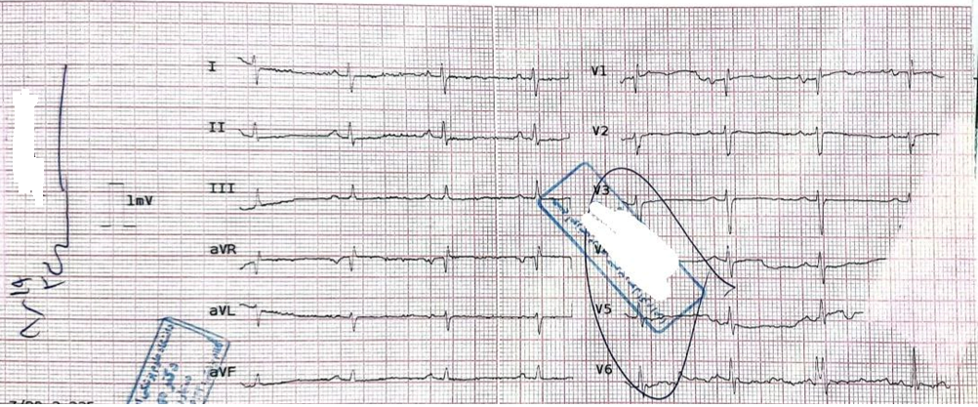
ECG

Slide 16
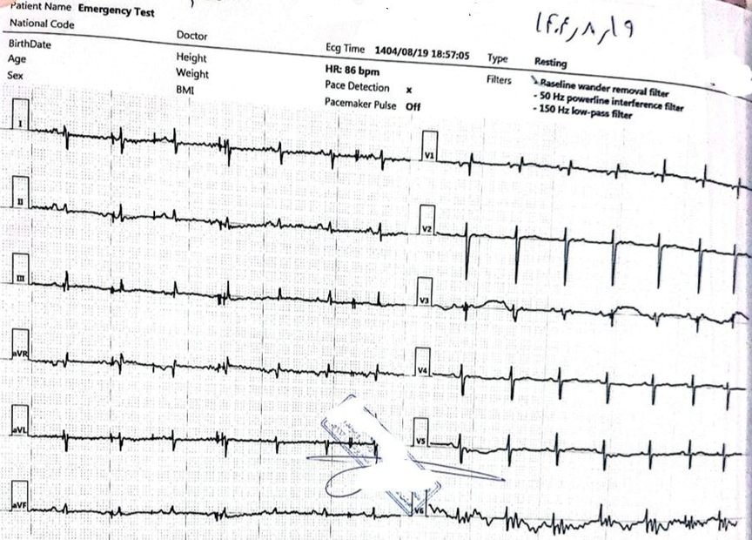

Slide 17
Laboratory Results
Test | Result | Unit
pH | 7.37
pCO₂ | 35.5 | mmHg
HCO₃ | 20.6 | mEq/L
Blood Sugar | 77 | mg/dL
BUN | 17 | mg/dL
Creatinine | 1 | mg/dL
AST | 30 | U/L
ALT | 24 | U/L
ALP | 151 | U/L
Bilirubin total | 2.1 | mg/dL
Bilirubin direct | 0.5 | mg/dL
Albumin | 3.7 | g/dL
Calcium | 8.9 | mg/dL
Phosphate | 3 | mg/dL
Test | Result | Unit
WBC | 6.2 | x10³/µL
Neutrophils | 70 | %
Lymphocytes | 23 | %
Hemoglobin | 15.2 | g/dL
RBC | 4.89 | x10⁶/µL
MCV | 98.2 | fL
Platelets | 139 | x10³/µL
PT | 15.1 | sec
INR | 1.14
PTT | 32 | sec
CRP | 1.9 | mg/L
Sodium | 143 | mEq/L
Potassium | 3.6 | mEq/L
Magnesium | 2 | mg/Dl
Test | Result | Unit
HbA1c | 6 | %
Serum Iron | 112 | µg/dL
TIBC | 381 | µg/dL
Ferritin | 28 | ng/mL
Vit D3 | 47 | ng/mL
Folic Acid | 9.4 | ng/mL
Pro-BNP | 5511 | pg/mL
CPK | 122 | U/L
CK-MB | 29 | U/L

Slide 18
Echocardiography
-Small size LV cavity with preserved systolic function (LVEF:50% by visual assesment confirmed by biplane Simpson's method). -No RWMA at rest. -No LVH -D shaped LV due to RV volume and pressure overload. -Severe RV enlargement with moderate systolic dysfunction. -RA enlargement, normal LA size (RA Area:22cm2, LA Area:12cma, LAESV:33ml, LAESVI:20ml/ma). -Normal MVLs, Mild MR, no MS. -Fused E and A waves by Doppler study of MV inflow due to tachycardia.
-Tricuspid AV, no Al, no AS, Mild Dilated ascending aorta with no visible flap of dissection on TTE
-Normal TVLs, Severe TR (TRG:80mmHg), no TS. -Normal PVLs, Mild to Moderate Pt (PIPG:40mmHg), no PS. -High probable for significant PH (based un indirect echo findings, SPAP:95mmlig. MPAP:55mmHg). -IVC Plethora. -Swinging heart with Large Circumferential Pericardial Effusion (Posterior to LV:2.5cm, Lateral to RA:2cm, Anterior to RV:0.5cm, Lateral to LV:2.2cm, Lateral to RV in sabxiphoid view:0.8cm) with compressive effect on cardiac chambers (LA collapse, significant respiratory variation on TV inflow (60%), IVC plethora).

Slide 19
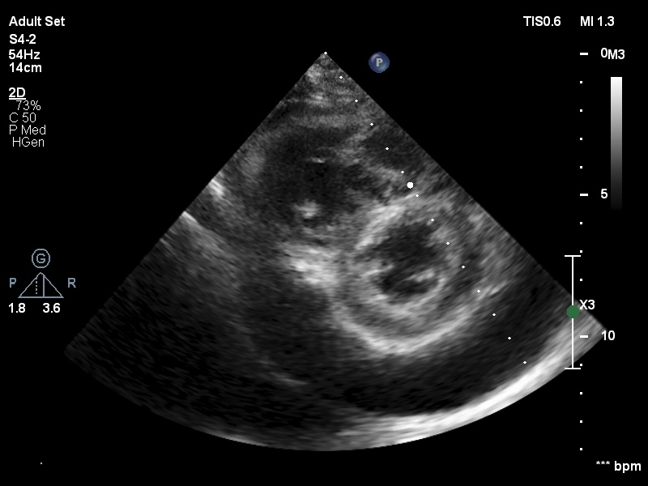
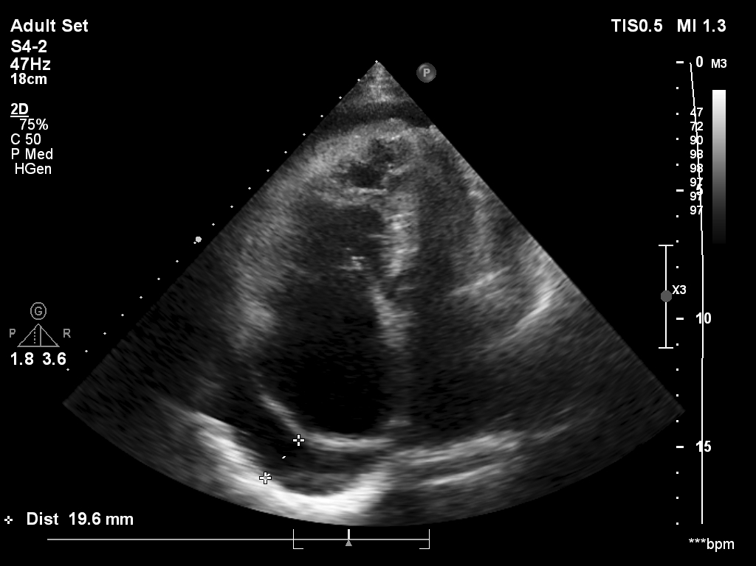
Echocardiography

Slide 20
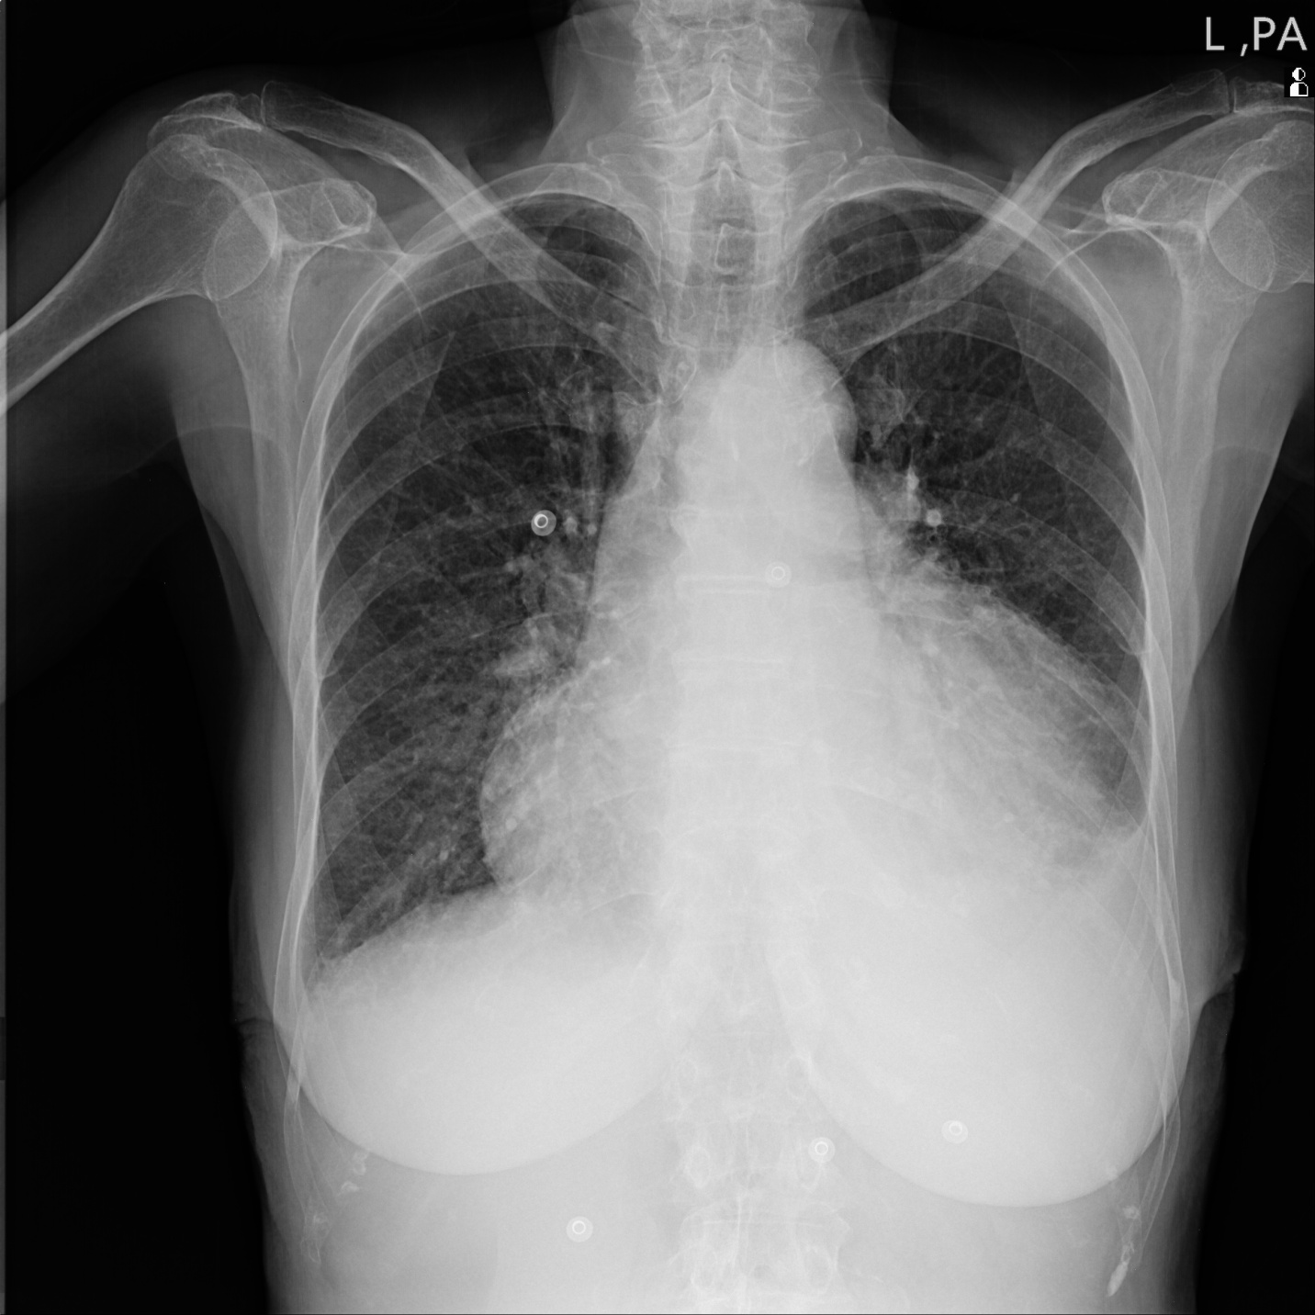
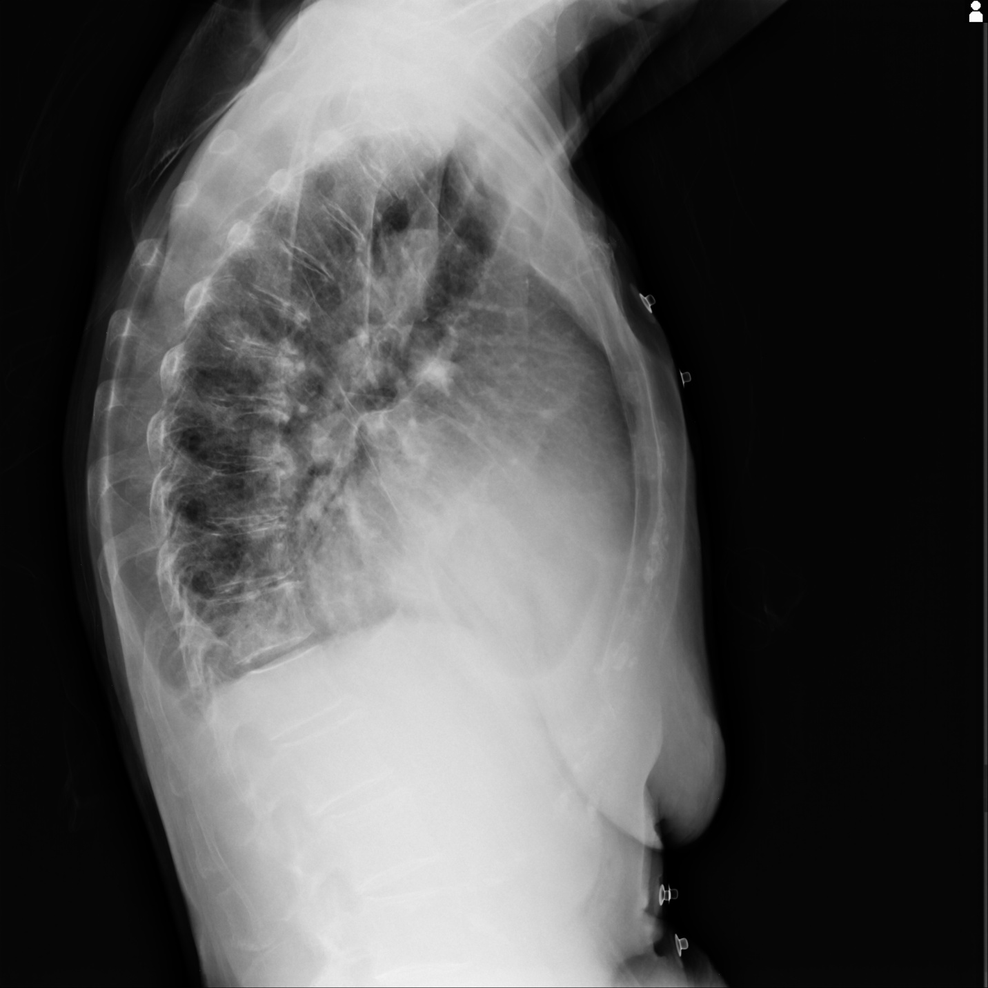
CXR

Slide 21
NEXT STEP

Slide 22
Pericardiocentesis + pericardial window
1404/08/20

Slide 23
PERICARD FLIUD ANALYSIS
Parameter | Result | Unit
Color | Dark yellow | —
Appearance | Semi-clear | —
RBC | 1,250 | /µL
WBC | 130 | /µL
Lymphocytes | 90 | %
Segmented neutrophils | 10 | %
Glucose | 100 | mg/dL
Protein | 1.7 | g/dL
Albumin | 1.1 | g/dL
LDH | 714 | U/L
ADA | 12.7 | U/L
Culture & Smear | Negative | —
Pericardial biopsy | Fibroconnective tissue | —
Parameter | Serum Value | Unit
Protein | 5.3 | g/dL
Albumin | 3.6 | g/dL
LDH | 870 | U/L

Slide 24
NEXT STEP

Slide 25
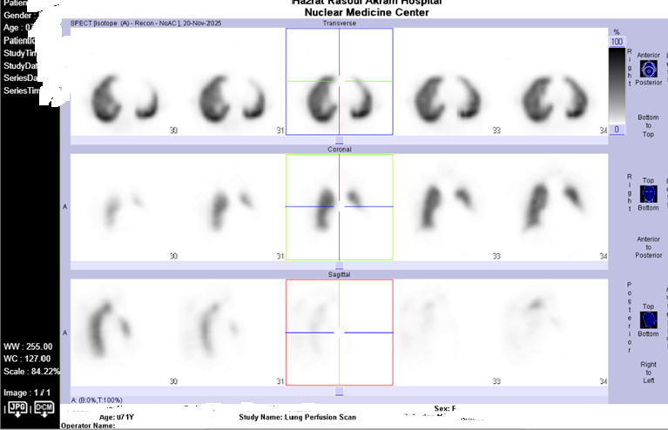
Pulmonary perfusion scan

Slide 26
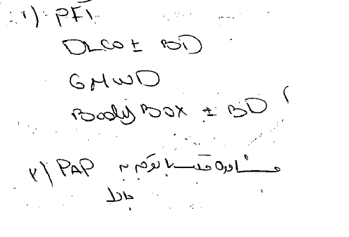
Pulmonary consult

Slide 27
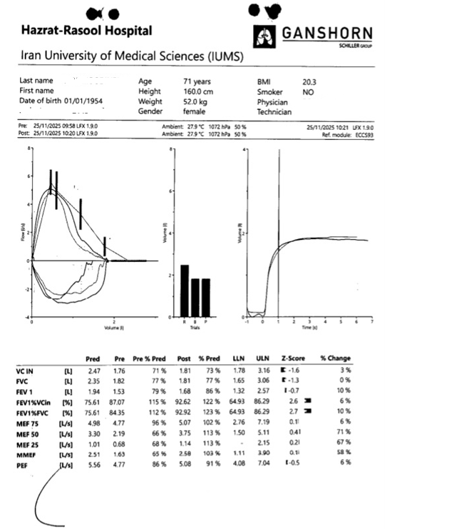

Slide 28
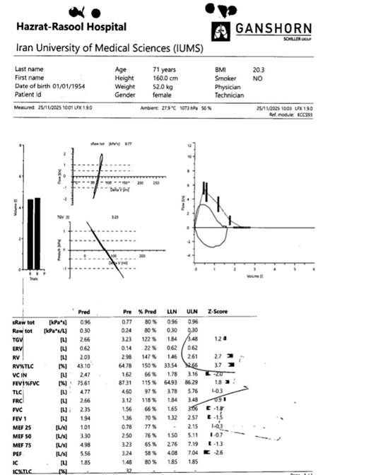

Slide 29
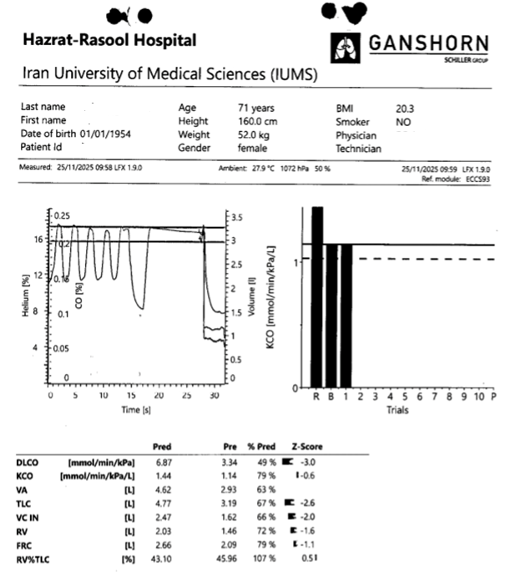

Slide 30
SPIRAL LUNG CTS WOC 1404/08/25
The distal tip of the central venous catheter was seen in the SVC.
Moderate left and mild right pleural effusion were observed.
Pericardial effusion with a maximum thickness of 9 mm adjacent to the RV was observed.
Calcification of the aorta and coronary arteries, as well as degenerative joint disease (DJD) changes of the vertebrae, were observed.
Evidence of a beaver tail liver was observed.
Consolidation with air bronchogram was seen in the RLL and LLL.

Slide 31
RHC
Hb | 10 | TPG | 38.6
BSA | 1.52 | DPG | 34
PAP | 61/47 | Ao Sat | 92%
Mean PAP | 51.6 | PA sat | 65%
PCWP | 13 | RV sat | 76%
RV | 42/20 | MVO | 62.5%
RA | 10 | PAPi | 1.4
Ao | 92%
MAP | 124
CO T | 2.6 | SVR | 1860 dyn
CO F | 4.9 | C1 T | 1.9
PVR | 7.9 | C1 F | 3.2

Slide 32
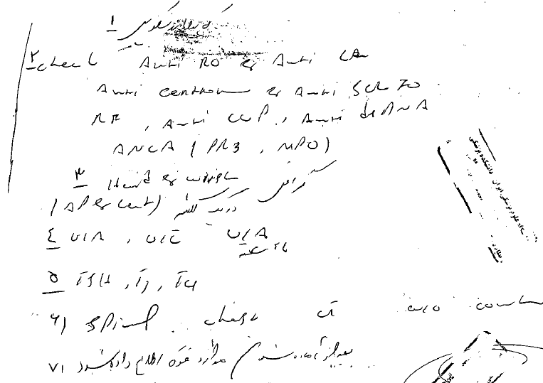
Rheumatology consult

Slide 33
Test | Result | Unit
CA125 | 102.8 | U/mL
CEA | 1.1 | ng/mL
AFP | 8.6 | ng/mL
TSH | 9.2 | µIU/mL
T4 | 8.6 | µg/dL
T3 | 67 | ng/dL
RA factor | 21 | IU/mL
ANA | 0.824
Anti-dsDNA | >100 | IU/mL
Anti-CCP | Negative
SSA/Ro | 1.6
SSB/La | 5
C-ANCA | 3
P-ANCA | <3
Anti-Centromere Ab(IgG) | 328.5 | U/mL
Anti SCL-70 Ab | 0.1 | U/mL
HIV | Negative
Viral Hepatitis | Negative

Slide 34
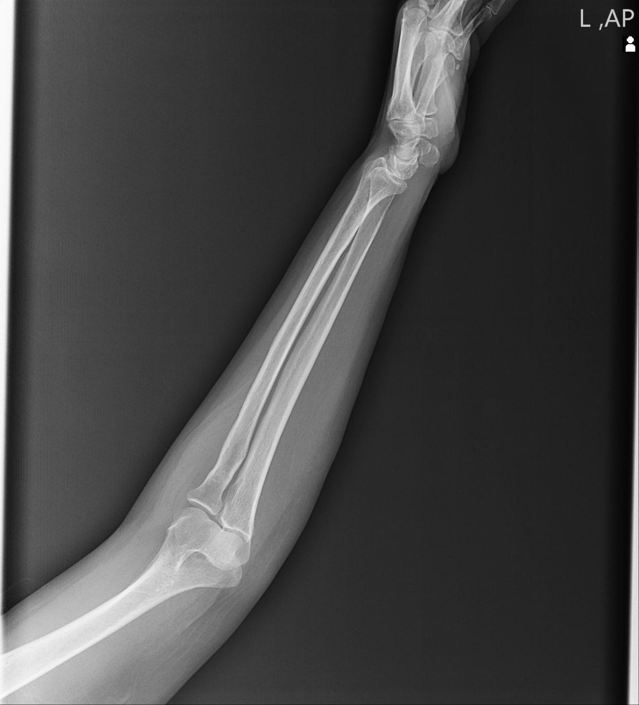
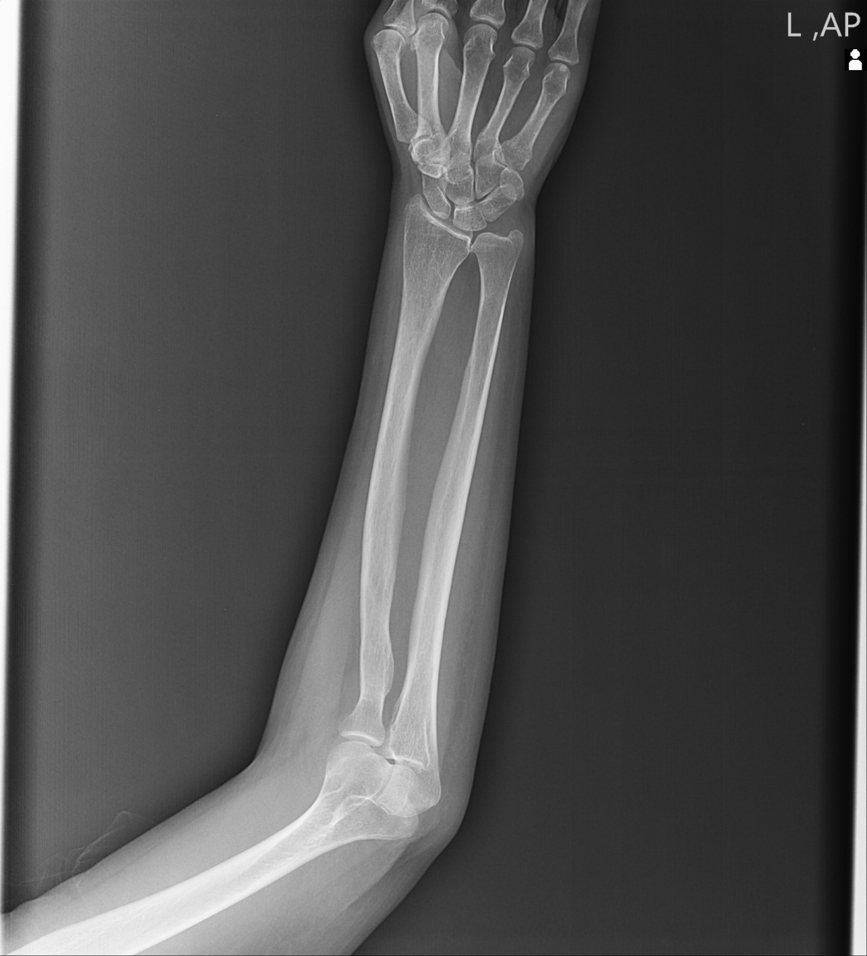

Slide 35
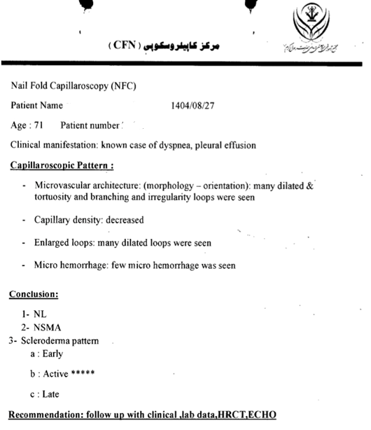

Slide 36
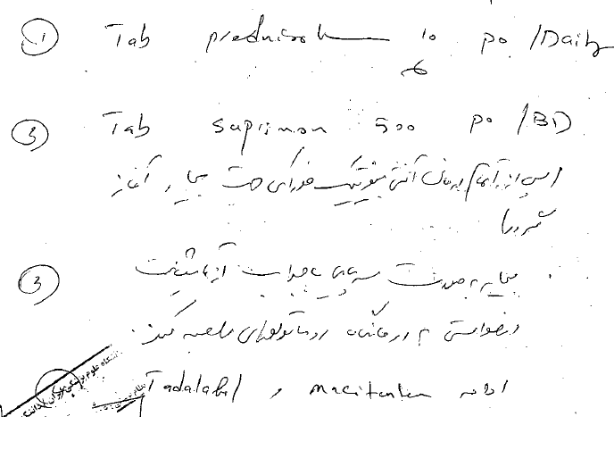
Rheumatology consult

Slide 37
SPIRAL LUNG CTS WOC 1404/09/06
Cardiomegaly was observed.
Severe pericardial effusion with a maximum thickness of 37 mm was observed.
Aortic atherosclerosis was observed.
The MPA is enlarged and measures 32 mm; echocardiography is recommended.
Mild left pleural effusion was observed.
Band-like atelectasis was observed at the lung bases.

Slide 38
RECOMMENDATIONS AFTER DISCHARGE
TAB PREDNISOLONE 10mg D
TAB SUPRIMON 500mg BD
TAB TADALAFIL 5mg D
TAB LYRATAN 10mg D
TAB PANTOPRAZOLE 40mg D
TAB Ca-D D
TAB ALDACTONE 25mg BD
TAB LOSARTAN 25mg BD
TAB Furosemide 40mg BD
TAB VIT B1 300 D
TAB COLCHICINE 0. 5 ½ BD

Slide 39
Echocardiography F/U
**History of surgical drainage of pericardial effusion one month ago
-Small size LV cavity(LVEDVi:30cc/m2) with preserved systolic function (LVEF:50-55%)
-Septal wall flattening due to RV pressure overload.
-No LVH. -Grade I LV diastolic dysfunction -Normal RV size with preserved systolic function.
-Normal size biatrial (RA Area:10cm2, RAVi:15cc/m2 LAVi:10cc/m2). -Normal MVLs, Mild MR, no MS.
-Tricuspid AV, No AI, no AS, Normal ascending aorta. -Normal TVLs,Mild to Moderate TR (TRG:48mmHg), no TS.
-Normal PVLs, Mild to Moderate PI (PIPG:26mmHg), no PS,normal size of main of PA(1.9cm)
-High probability for PH ;TRVmax:3.4m/sec,PIVmax:2.5m/sec,shortened PV accleration time(56m/sec) ,SPAP:51mmHg,flattering of IVS.EPLAR=0.34 which is suggestive of pre-capillary PH
-Normal size IVC with >50% respiratory variation.
-Mild to moderate circumferential pericardial effusion (lateral to RV:13mm, lateral to LV:7mm, Anterior to RV:7mm , Around the RA:7 mm , Around apex:14mm) with RA inagination.

Slide 40
Beyond the clinical findings, this case reminds us that every diagnosis represents a person who trusted us with their care.
THANK YOU

